Slide 1
cxaca

Slide 2
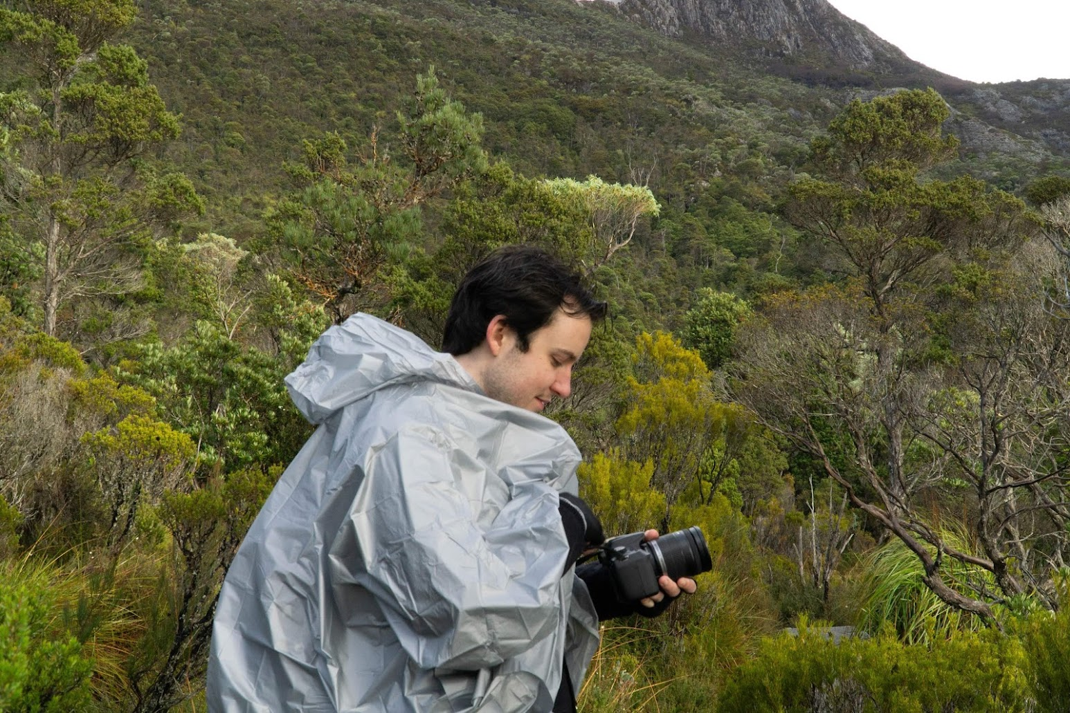
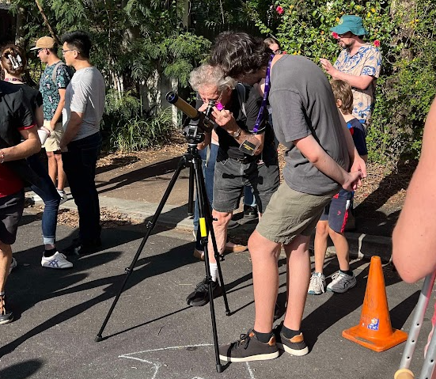




A little bit about me
UQ (Brisbane)
Undergrad + Honours at the University of Queensland
I love some science outreach
Writer for astrobites
Always looking for more public outreach e.g. solar telescopes, talks
Recently moved to Sydney for MRes+PhD at Macquarie with Orsola De Marco and Ben Pope
Macquarie Uni
(Sydney!)

Slide 3
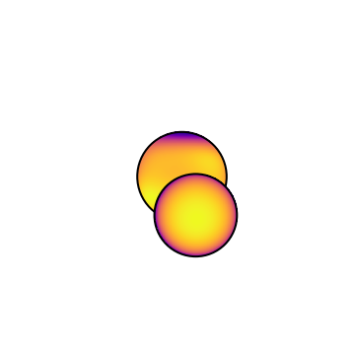
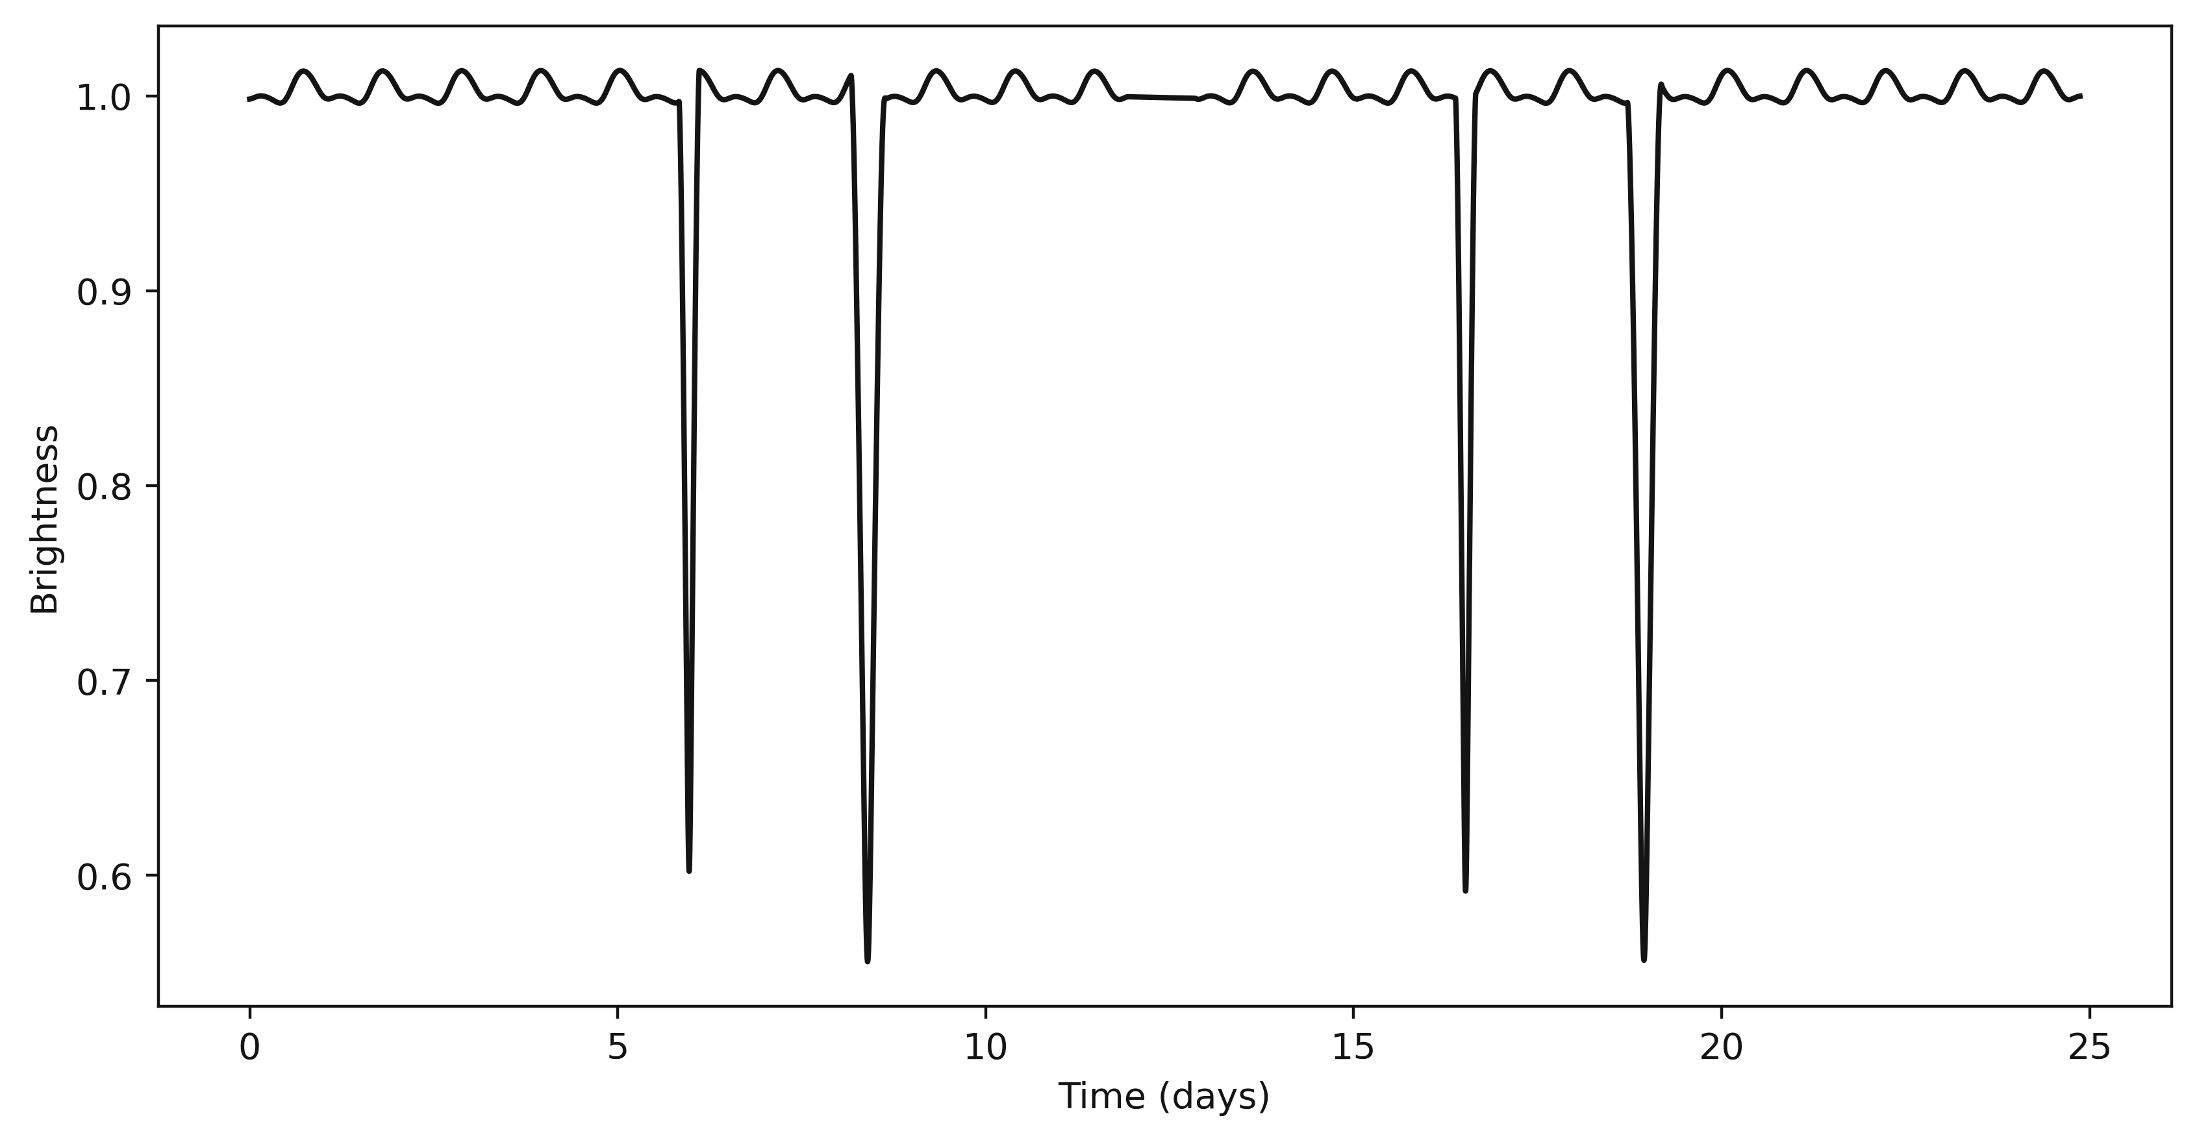
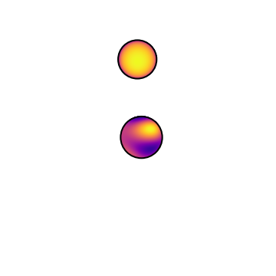
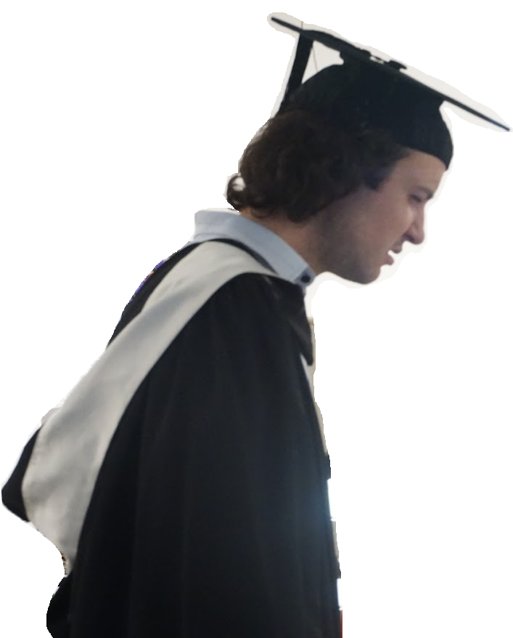
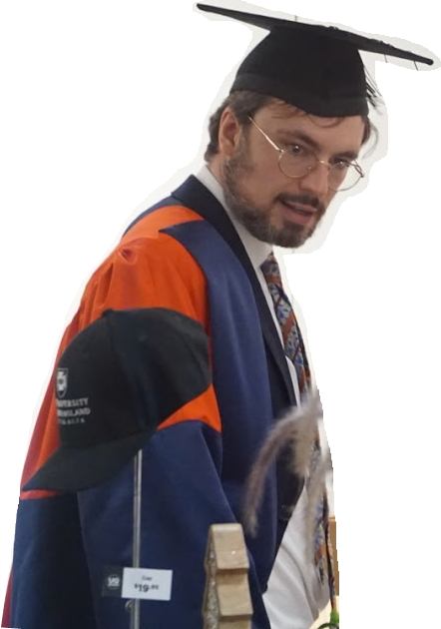
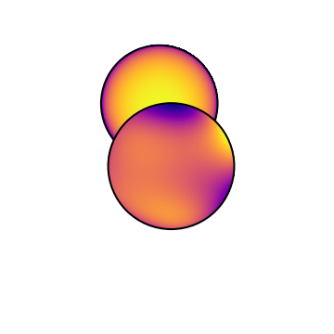
My previous work… at Uni of Queensland
Worked with Benjamin Pope and Shashank Dholakia to map the surface of the stars in DI Herculis using its TESS light curve

Slide 4
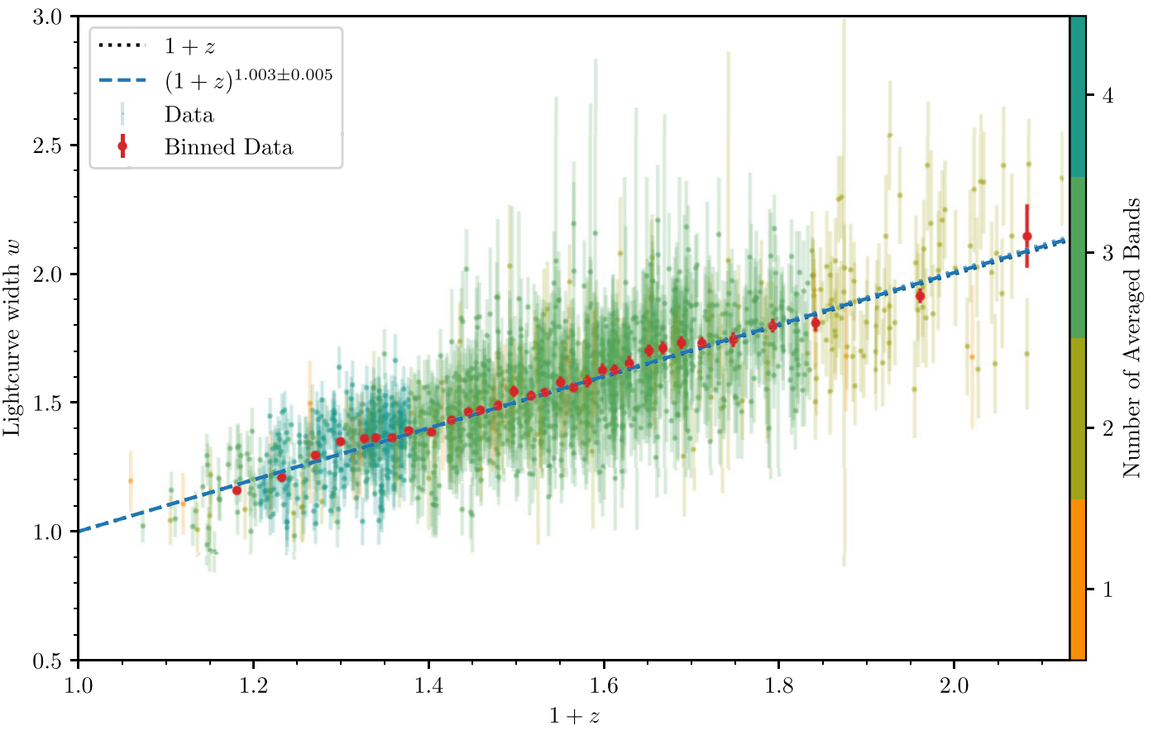
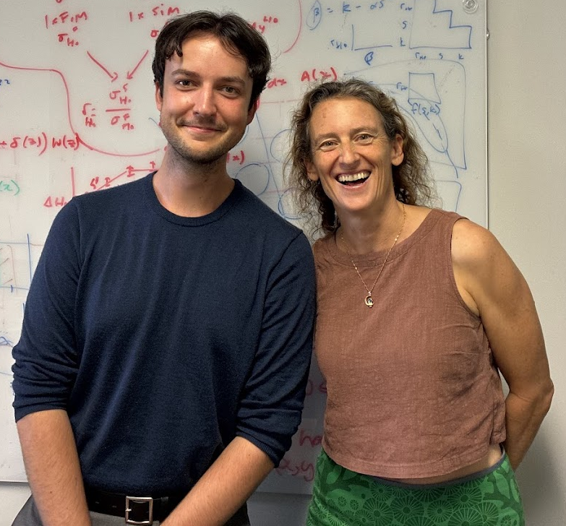
My previous work… at Uni of Queensland
Worked with Tamara Davis to show cosmological time dilation in ~1500 Type Ia supernovae from the Dark Energy Survey (DES)

Slide 5

























































































































































































































































































































































































































































My previous work… at UQ
or

Slide 6
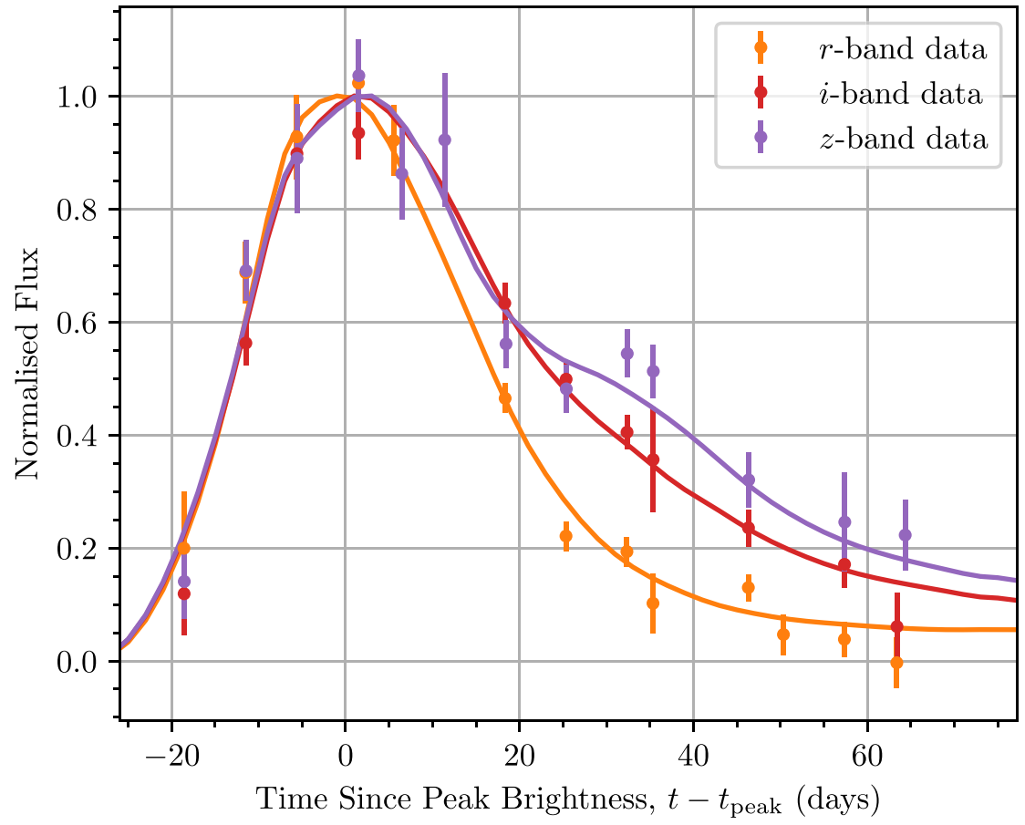
































My previous work… at UQ
Day 0
Day 20
Day 60

Slide 7
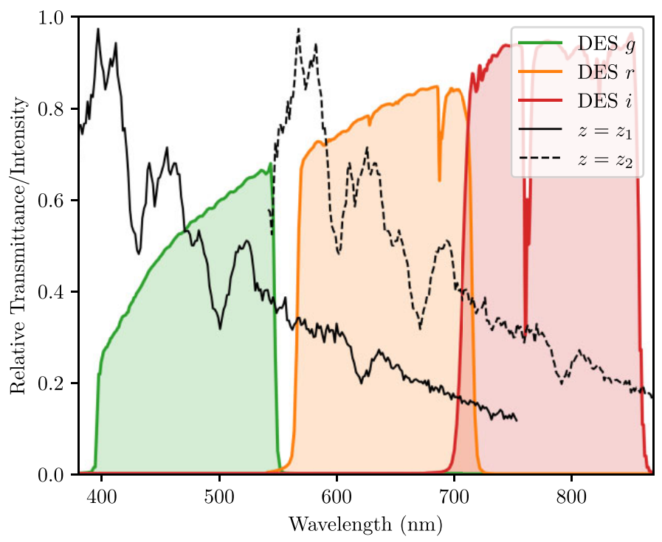

















My previous work… at UQ
Distance

Slide 8
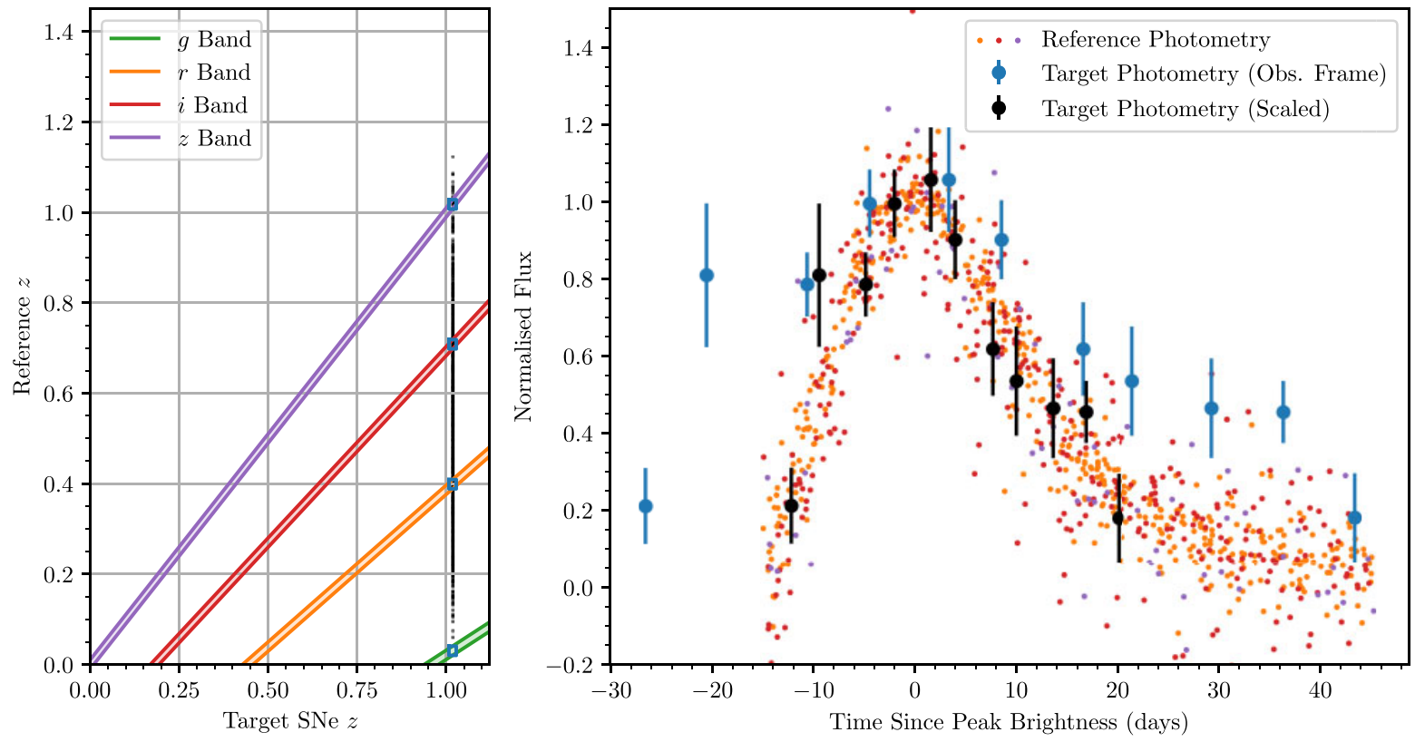
My previous work… at UQ

Slide 9
My previous work… at UQ
White, R. M. T., et al. (2024) "The Dark Energy Survey Supernova Program: slow supernovae show cosmological time dilation out to z~1.", MNRAS, 533, 3365

Slide 10
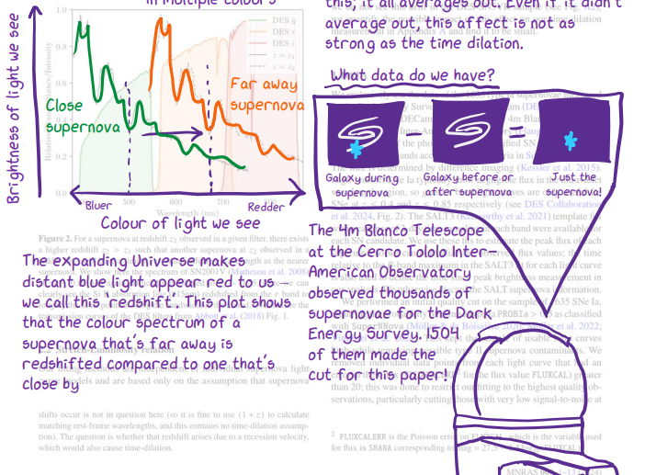
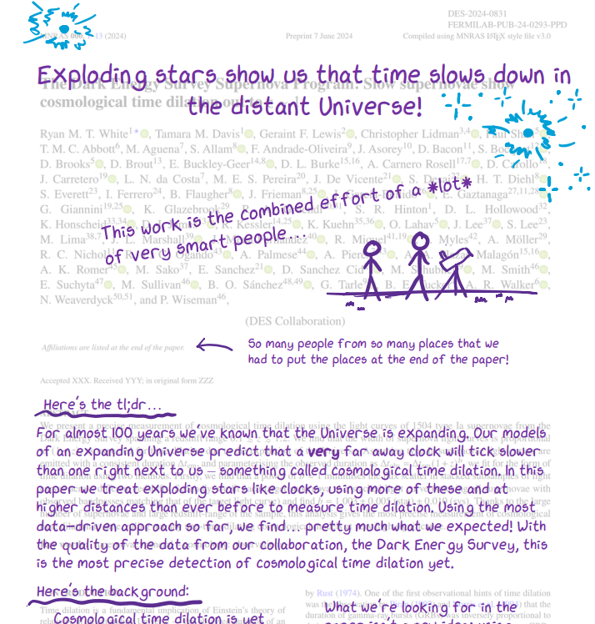
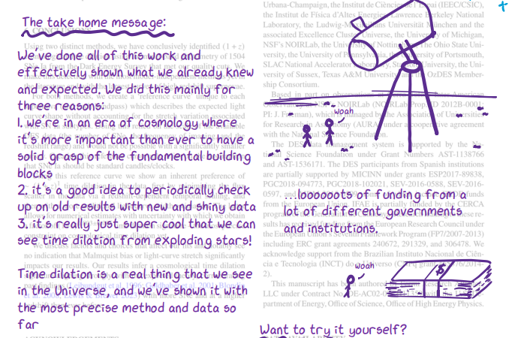

My previous work… at UQ
ryanwhite1.github.io/time-dilation.html

Slide 11




































































































































































My previous work… at Swinburne
Investigated the AGN channel of binary black hole mergers with Simon Stevenson
Integrating numerical relativity and disk models into the REBOUND code
This channel could explain very massive (hierarchical) mergers such as GW190521

Slide 12
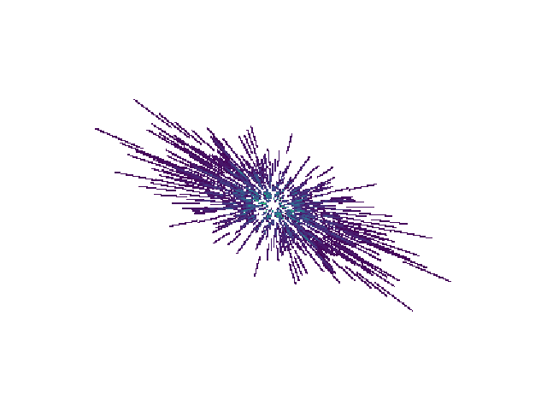
My previous work… at CSIRO
Developed a new method to search for Long Period Radio Transients with Andrew Zic
Transients are traditionally looked for by searching pixel by pixel in a set of images
With radio interferometric data, we can save computation (and time) by directly folding visibilities at trial periods

Slide 13
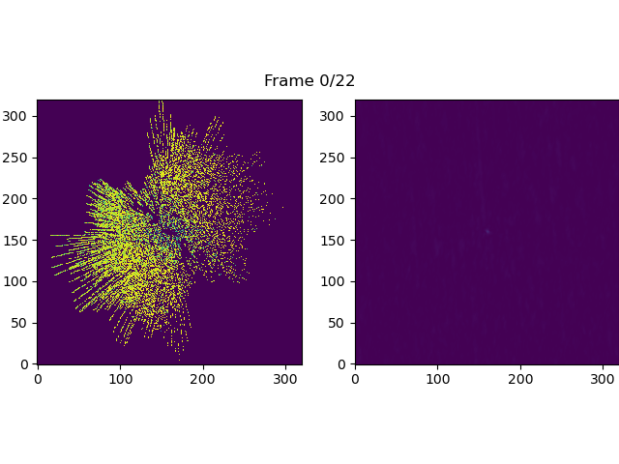
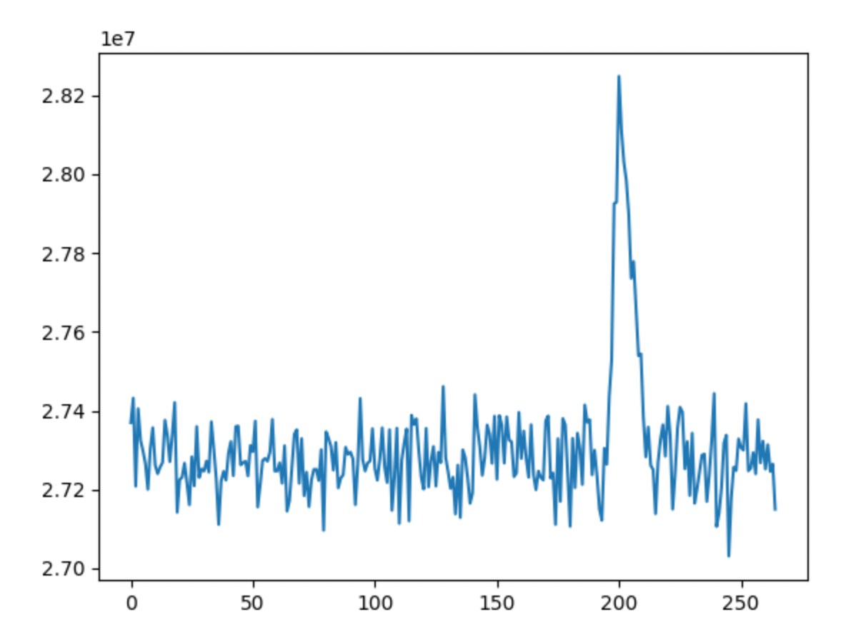
My previous work… at CSIRO
UV Plane
Image Plane
Folded Radio Lightcurve
Frame

Slide 14
































A common theme?

Slide 15
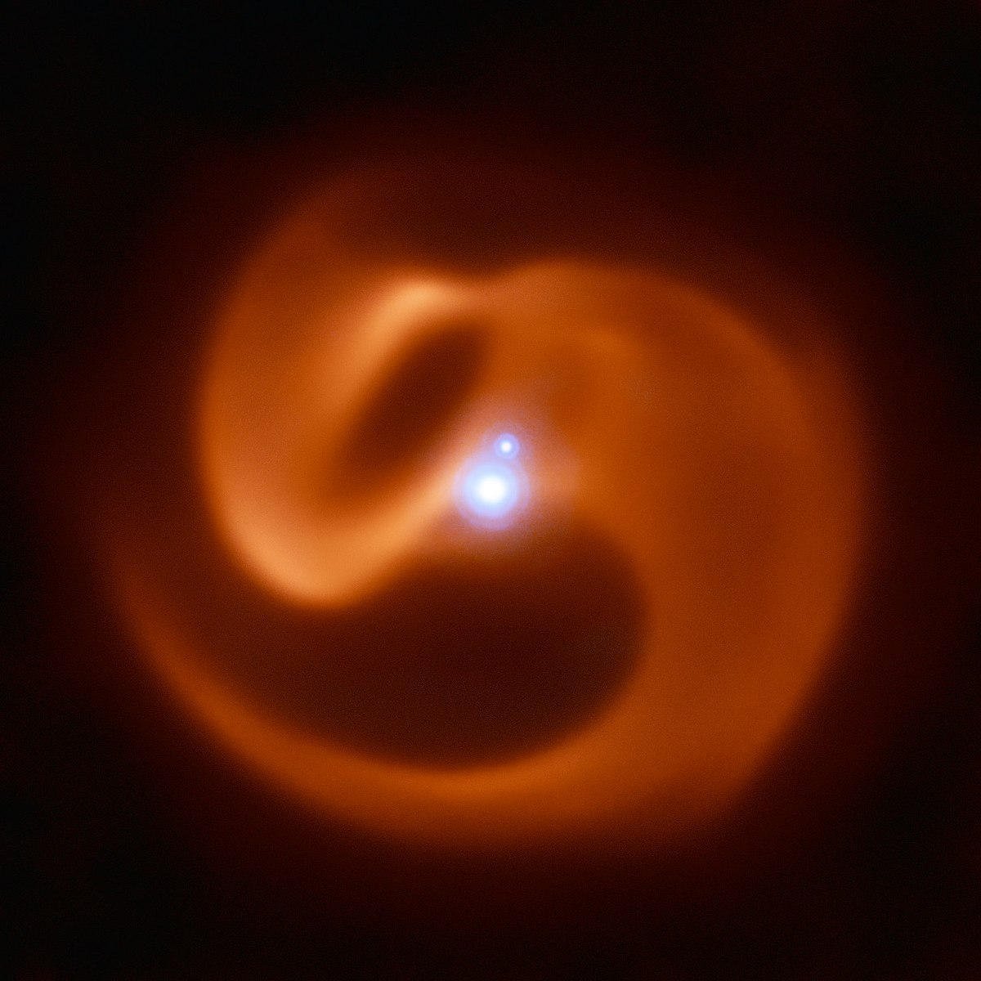
Colliding Wind Binaries

Slide 16
Colliding Wind Binaries
Are the dominant influences on their environment,
made up a large part of the Universe’s early carbon content,
allow us to peer into binary stellar evolution and the evolution of massive stars,
and just look unreasonably cool.

Slide 17
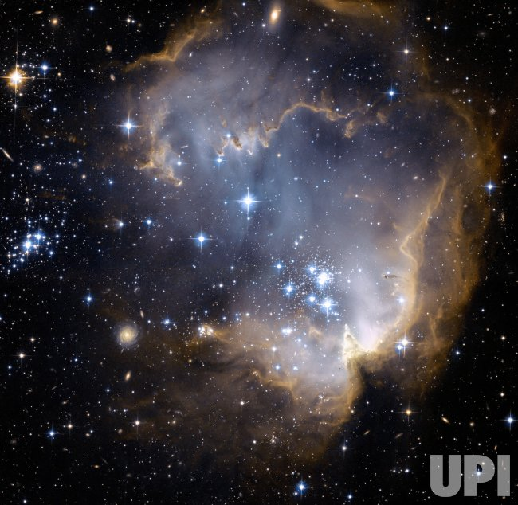


































































A broad overview of massive stellar evolution
Neutron Star
OB Star
Red Supergiant
Then spends the majority of its life on the main-sequence burning hydrogen into heavier elements
Blue Supergiant
Supernova
Our massive star is
born from the collapse
of a molecular cloud
Wolf-Rayet Star
Black Hole

Slide 18
















































A broad overview of massive stellar evolution
binary
O+OB Stars
Mass Transfer
First SN
Stellar
Merger
Final Product
Second SN
Our massive stars are
born from the collapse
of a molecular cloud

Slide 19
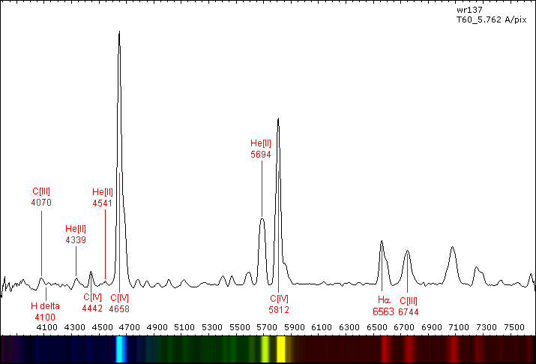





















Wolf-Rayet stars
C/N/O Core
He Shell

